Slide 1
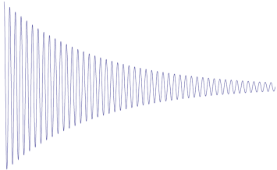


(a)
H5
H1
H4
H2
H3
(b)
$$π/2$$
$$π$$
t2
t1
(c)

